Slide 1
LIBRARY MANAGEMENT SYSTEM
Project guide
Shaik.NagurVali
sir
Team Members:
Polagani Dhanush (22AG1A6752)
Kalva Kasaiaha (22AG1A6730)
B.Harish (23AG5A6702)
Vishnubhatla Archana (22AG1A6764)

Slide 2
CONTENTS
Abstract
Problem Identification
Software Requirements
Hardware Requirements
Existing System
Proposed Model
Methodology
System Architecture
Functional Requirements
Non Functional Requirements
Module Description

Slide 3
ABSTRACT
The LMS is a powerful software application designed for efficient management of library resources and services. Administrators benefit from secure access to manage the library’s collection, while students enjoy a user-friendly interface accessible via university-issued IDs. Additionally, the system now includes automatic Gmail notifications to remind students of late book submissions.

Slide 4
Problem Identification
Accessibility Concerns: The system may not be fully accessible to users with disabilities, leading to exclusion and compliance issues.
Maintenance and Support: Inadequate support or maintenance resources can result in delays in addressing technical issues or implementing necessary updates and enhancements.
Scalability: Inability to handle growing collections or increasing numbers of users can constrain the system's effectiveness over time.
Security Vulnerabilities: Weak security measures may expose sensitive patron information to unauthorized access or compromise the integrity of the system.

Slide 5
SOFTWARE REQUIREMENTS
Operating System :windows InTEL/Ryzon
Database :MySQL
Programming Languages: php , html, css .
Browser: Google chrome , Microsoft edge.
Server: xampp

Slide 6
HARDWARE REQUIREMENTS
Processor:A multi-core processor (e.g., Intel Core i3 or i5 equivalent)
RAM:At least 4 GB of RAM is recommended to ensure smooth operation.
Storage: A solid-state drive (SSD) or hard disk drive (HDD) with sufficient storage capacity (e.g., 128 GB or more).
Network Interface:A Gigabit Ethernet interface for fast network connectivity

Slide 7
EXISTING SYSTEM
Library Catalog.
Member Records.
Circulation Management.
Cataloging and Classification
Search and Discovery
Integration with Other Systems

Slide 8
PROPOSED SYSTEM
The Gmail automation feature integrates with the LMS to automatically send reminder emails to patrons who have overdue library materials. By leveraging Gmail's API and scheduling capabilities, the system can send personalized reminders to patrons, prompting them to return borrowed items on time.

Slide 9
METHODOLOGY
User Authentication and Authorization.
Data Input and Validation.
Data Processing and Manipulation
Data Storage and Retrieval.
User Interface and Interaction.
Security and Compliance.

Slide 10
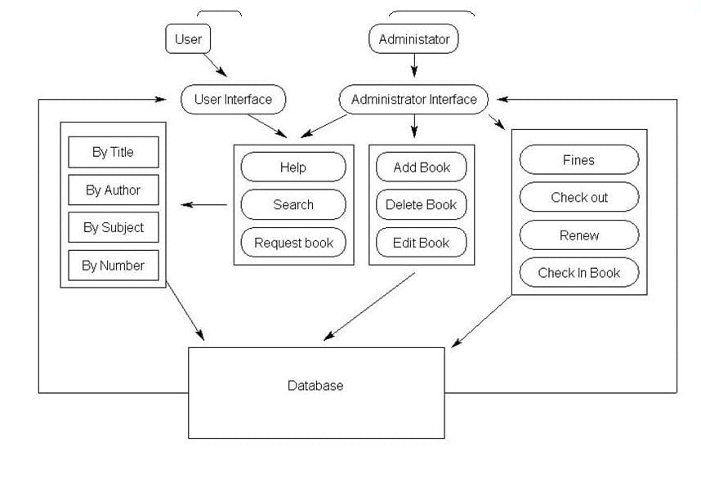
SYSTEM ARCHITECTURE

Slide 11
FUNCTIONAL REQUIREMENTS
User Registration and Authentication: Allow users to register for an account and authenticate themselves to access the system.
Check-out and Check-in: Allow users to borrow books from the library by checking them out and return them by checking them in. Ensure that the system updates the availability status of books accordingly.
Fines and Fees: Implement a system to calculate fines for late returns and manage payment of fines by users.
Notifications: Send automated notifications to users for overdue items, reservation pickups, or other relevant updates.
Backup and Recovery: Set up regular backups of the system data and implement procedures for disaster recovery to minimize the risk of data loss.

Slide 12
NON-FUNCTIONAL REQUIREMENTS
Performance :
1 . Response Time: The system should respond to user actions within a defined timeframe, typically milliseconds or seconds.
2 . Scalability: The system should be able to handle increased loads without significant degradation in performance.
Reliability:
1. Backup and Recovery: Regular backups of data should be performed, and there should be procedures in place to recover data in case of loss or corruption.
Security:
1. Data Encryption: Sensitive data such as user information, borrowing history, and financial transactions should be encrypted to protect against unauthorized access.
Maintainability:
1 . Code Quality: The codebase should adhere to coding standards and best practices, making it easier to understand, debug, and enhance in the future.

Slide 13
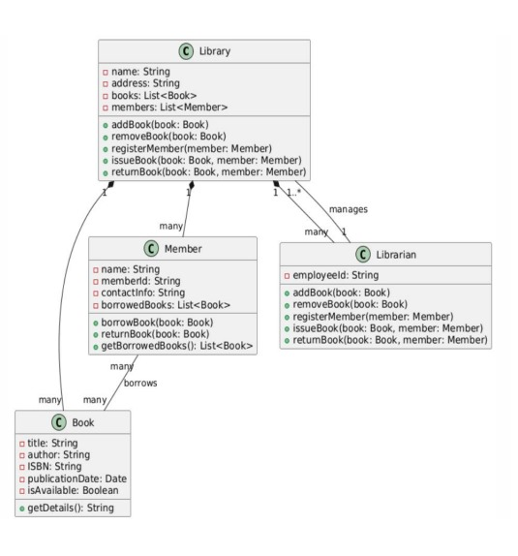
Uml Diagrams
Class diagrams:
A class diagram in the Unified Modeling Language (UML) is a type of static structure diagram that describes the structure of a system by showing the system's classes, their attributes, operations (or methods), and the relationships among the classes. It explains which class contains information

Slide 14
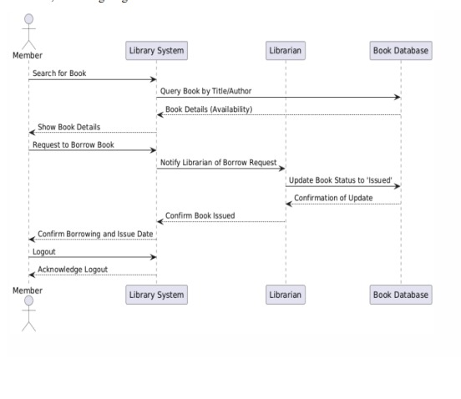
2.Sequence diagram
A sequence diagram in Unified Modeling Language (UML) is a kind of interaction diagram that shows how processes operate with oneanother and in what order. It is a construct of a Message Sequence Chart.Sequence diagrams are sometimes called event diagrams, event scenarios,and timing diagrams.

Slide 15
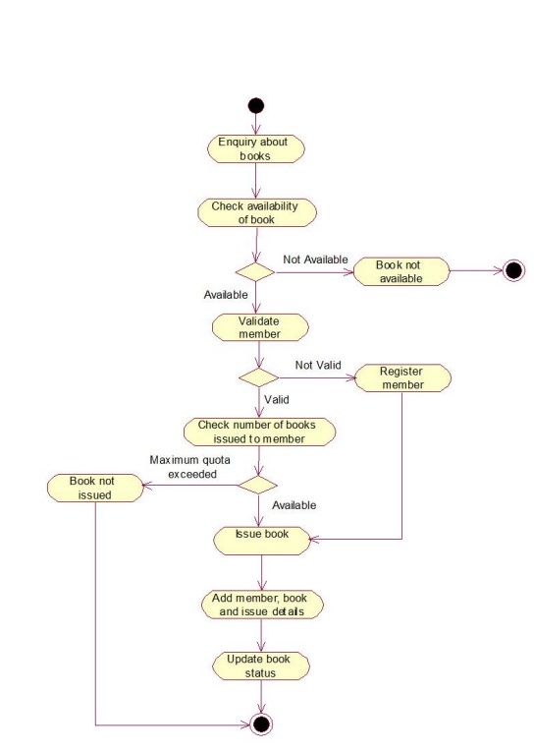
3.ACTIVITY DIAGRAM
The activity diagram is used to demonstrate the flow of control within the system rather than the implementation. It models the concurrent and sequential activities. The activity diagram helps in envisioning the workflow from one activity to another.
The flow can be sequential, branched, or concurrent, and to deal with such kinds of flows, the activity diagram has come up with a fork, join, etc. It is also termed as an object oriented flowchart.

Slide 16
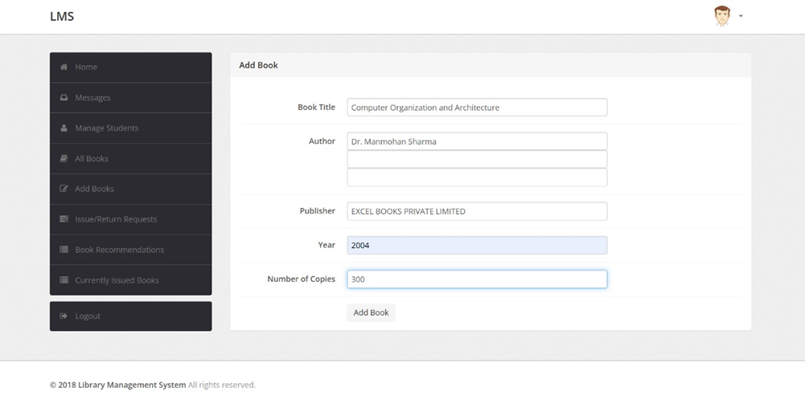
OUTPUT:-
In this image we are trying to add the book.

Slide 17
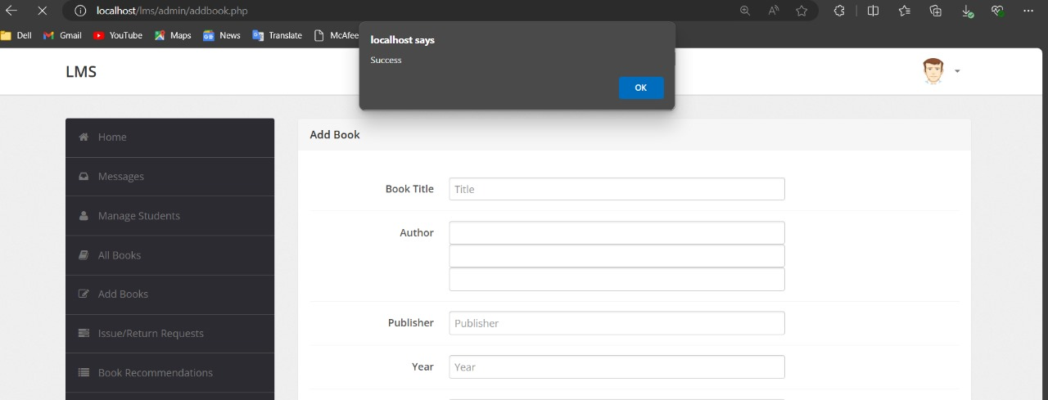
In this image the book we were trying to add and the book has been added successfully.

Slide 18
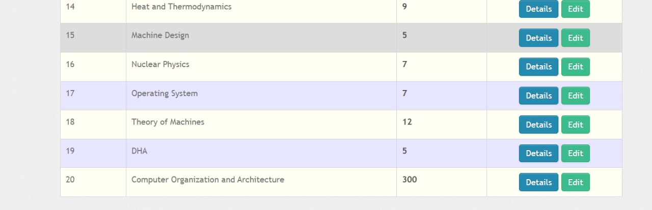
In this image the book we have added is shown here in this image.

Slide 19
CONCLUSION:-
In conclusion, analyzing the results from a Library Management System (LMS) is crucial for optimizing library services and enhancing user satisfaction. By thoroughly examining data on resource usage and user interactions, libraries can make informed decisions about acquisitions, inventory management, and service improvements. This data-driven approach allows libraries to better meet the evolving needs of their patrons, ensuring that they remain valuable and relevant community resources.

Slide 20
FUTURE SCOPE:-
Enhanced User Experience:
Personalized Services: Developing sophisticated algorithms to tailor recommendations and services based on individual user preferences and behavior.
Mobile and Remote Access: Expanding mobile app functionalities and remote access options to provide users with seamless access to library resources anytime, anywhere.
2. Improved Data Analytics:
Big Data: Utilizing big data analytics to gain deeper insights into user behavior, resource usage, and trends, enabling more strategic decision-making.
Real-time Analytics: Implementing real-time data processing to monitor library operations and user interactions dynamically.

Slide 21


